Slide 1

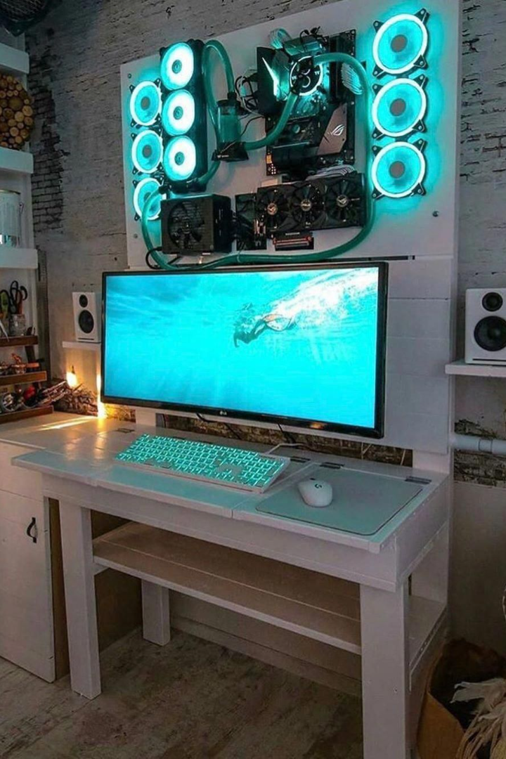
Dive into "PlayFinity"
Welcome to PlayFinity , the ultimate gaming website where you can download a wide variety of games. Experience thrilling adventures, intense battles, and endless fun!

Slide 2
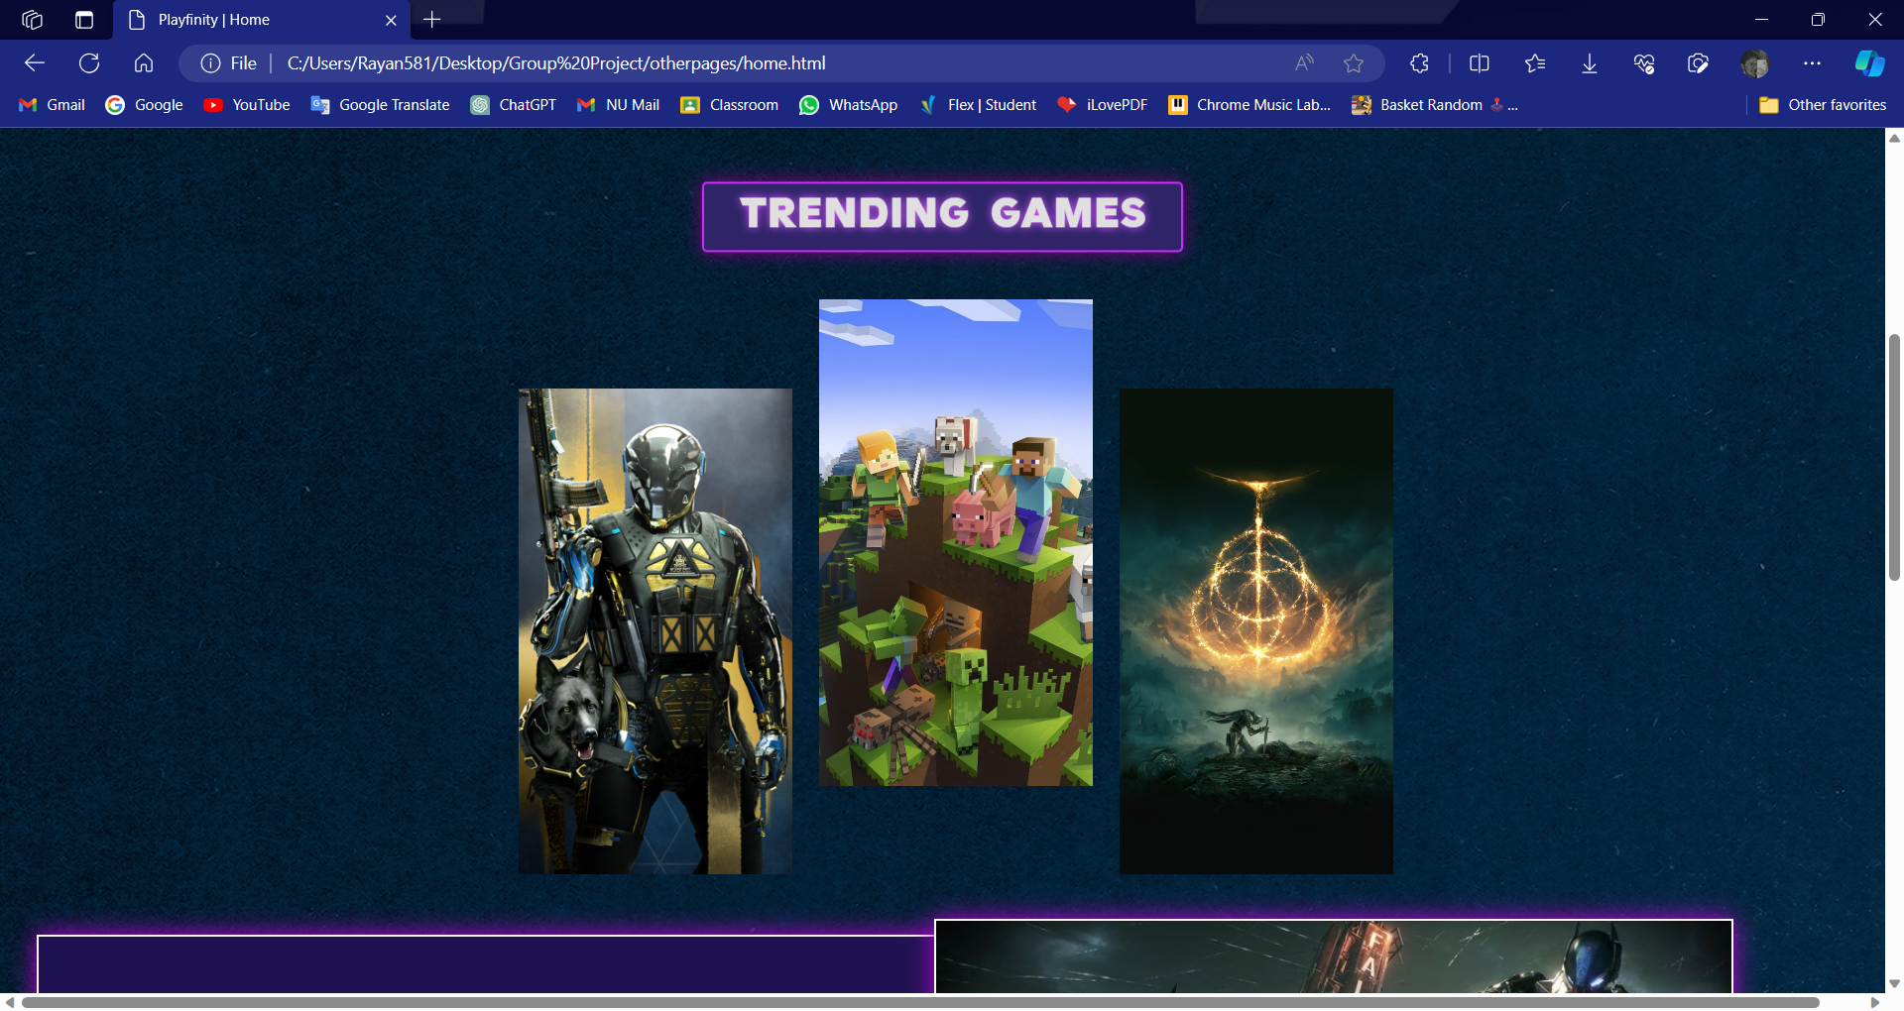
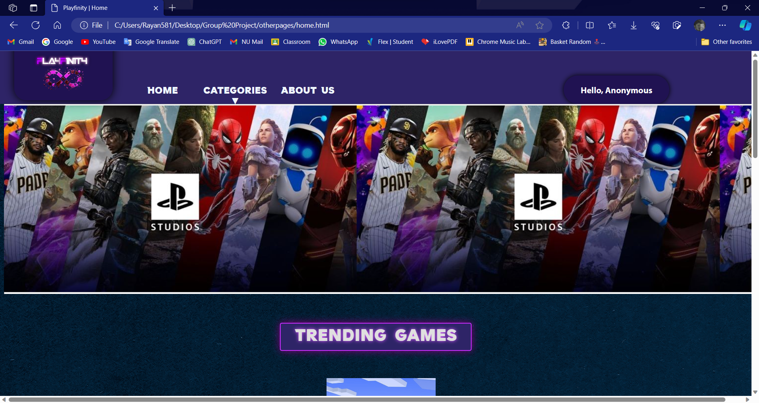
Home Page and Website Introduction
The home page displays the categories , an attractive background and an appealing webpages
As you can see that it gives you options to select the categories among which you can select the type of game you are search for.. Interesting? WE KNOW !!

Slide 3
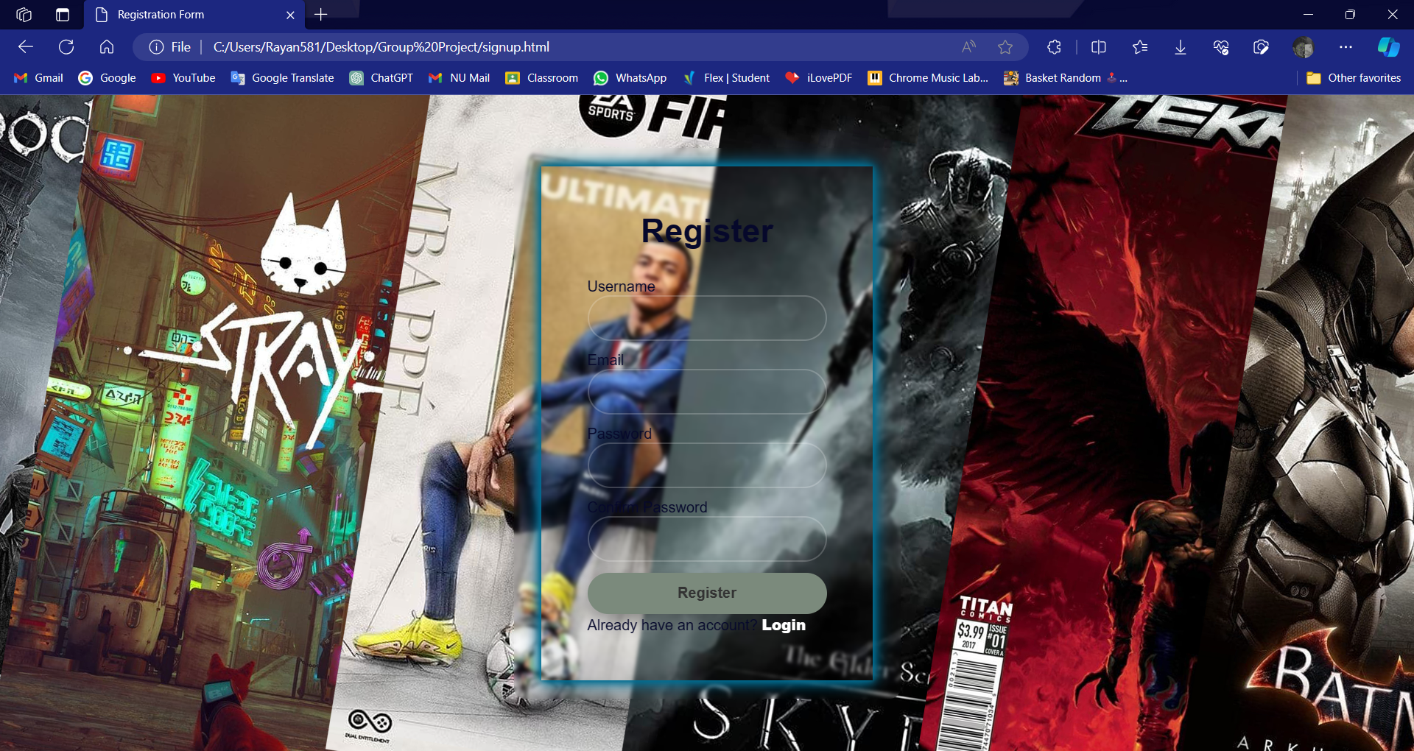
Register page
Register page is for new users who don’t have their accounts. And if you have then , by clicking “LOGIN” you can directly login to your account

Slide 4
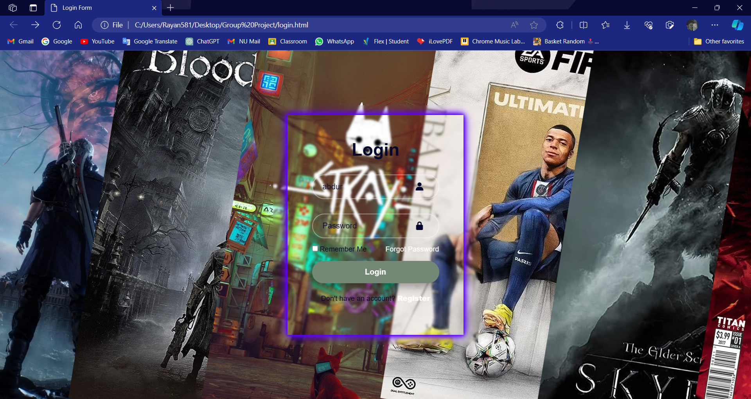
Login page
User can login to their account by the Login page and if the already have an account and if they don’t they foget their password they can recover their account by clicking “Forget password”

Slide 5
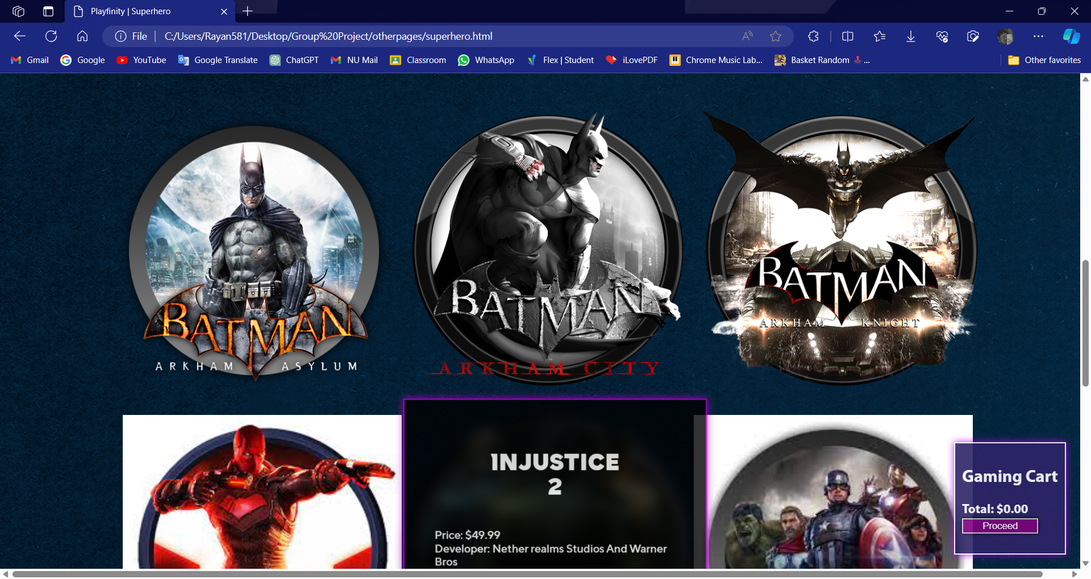
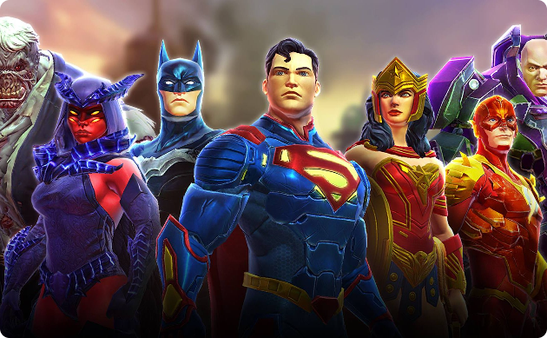
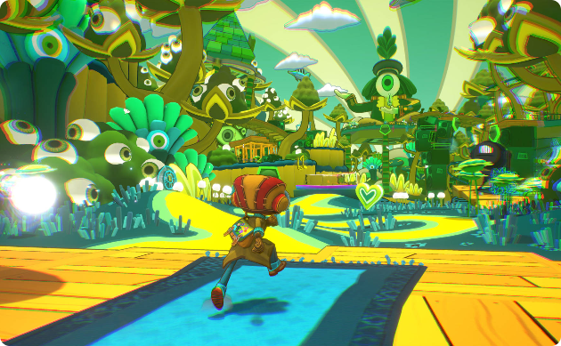
Category 1: Super Hero
Working
Popular Games
When you select the “superhero” category among all from the “category” button on the home page this page opens !! From where you find a large variety of games. YOU CAN HOVER ON ANY GAME AND IT WILL SHOW ALL THE DETAILS OF THE GAME.
Embark on thrilling journeys with games like "Spiderman series" "Batman Series", and "Gotham Knights".

Slide 6

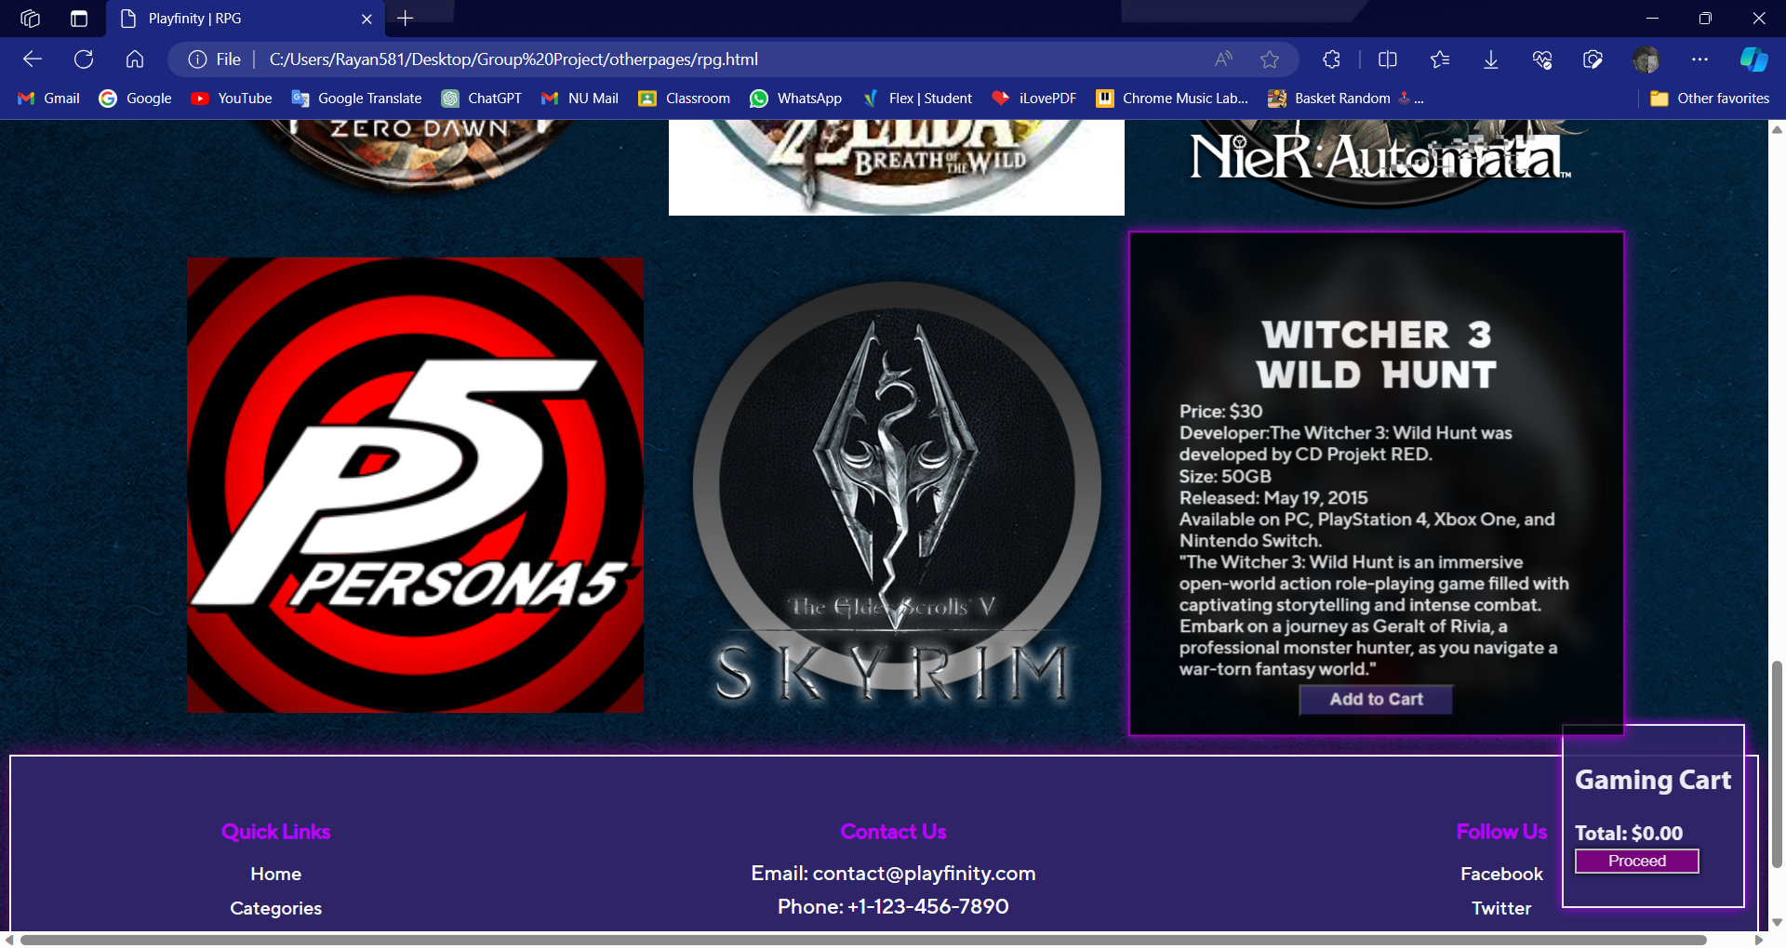
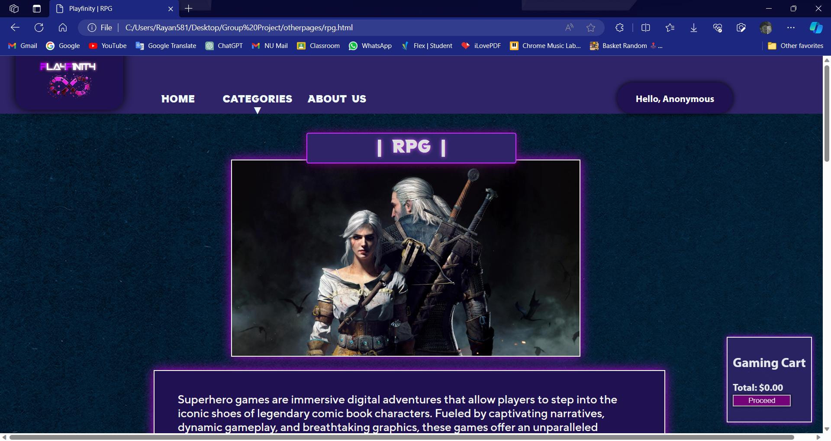
Category 2: RPG
RPG webpage gives you a large variety of RPG games and the working is exact same as the superhero page !
SIMPLE AND ELEGANT.
You can hover on any game and it will show you its price , size and every detail you are looking for !

Slide 7
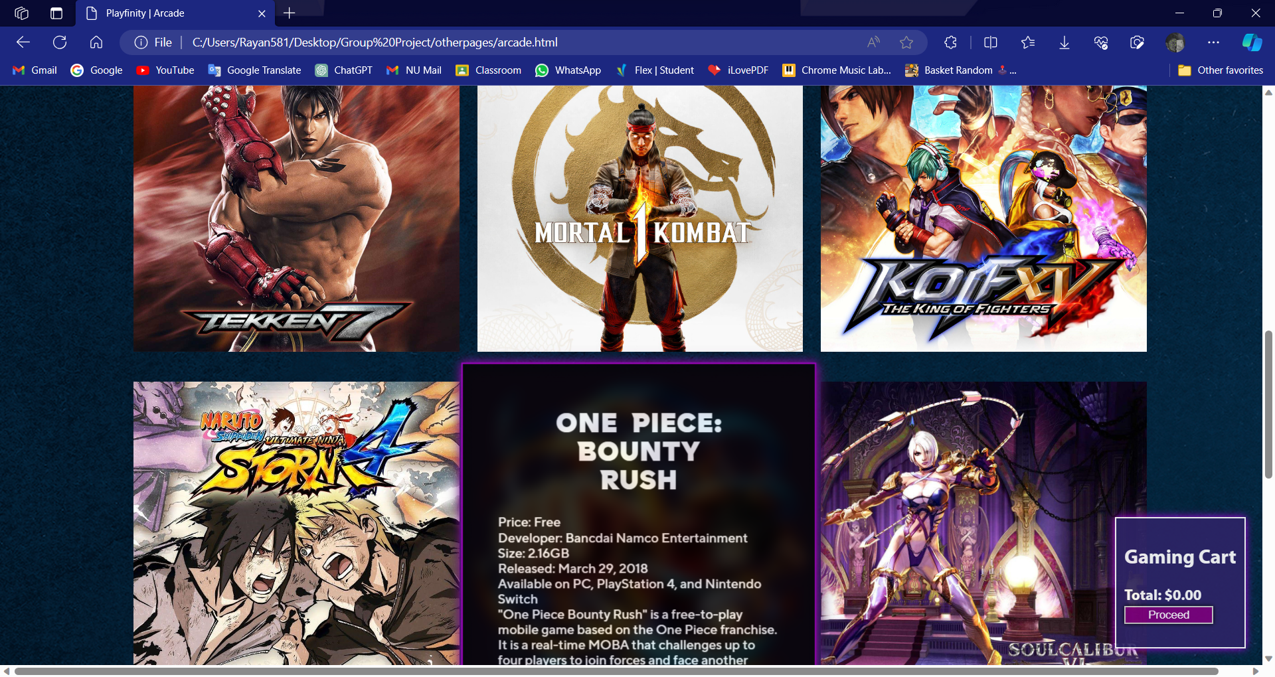
Category 3: Arcade
By selecting the “arcade” category this webpage will be at your service and it will let you choose frokm the immense collection of ARCADE GAMES !!

Slide 8
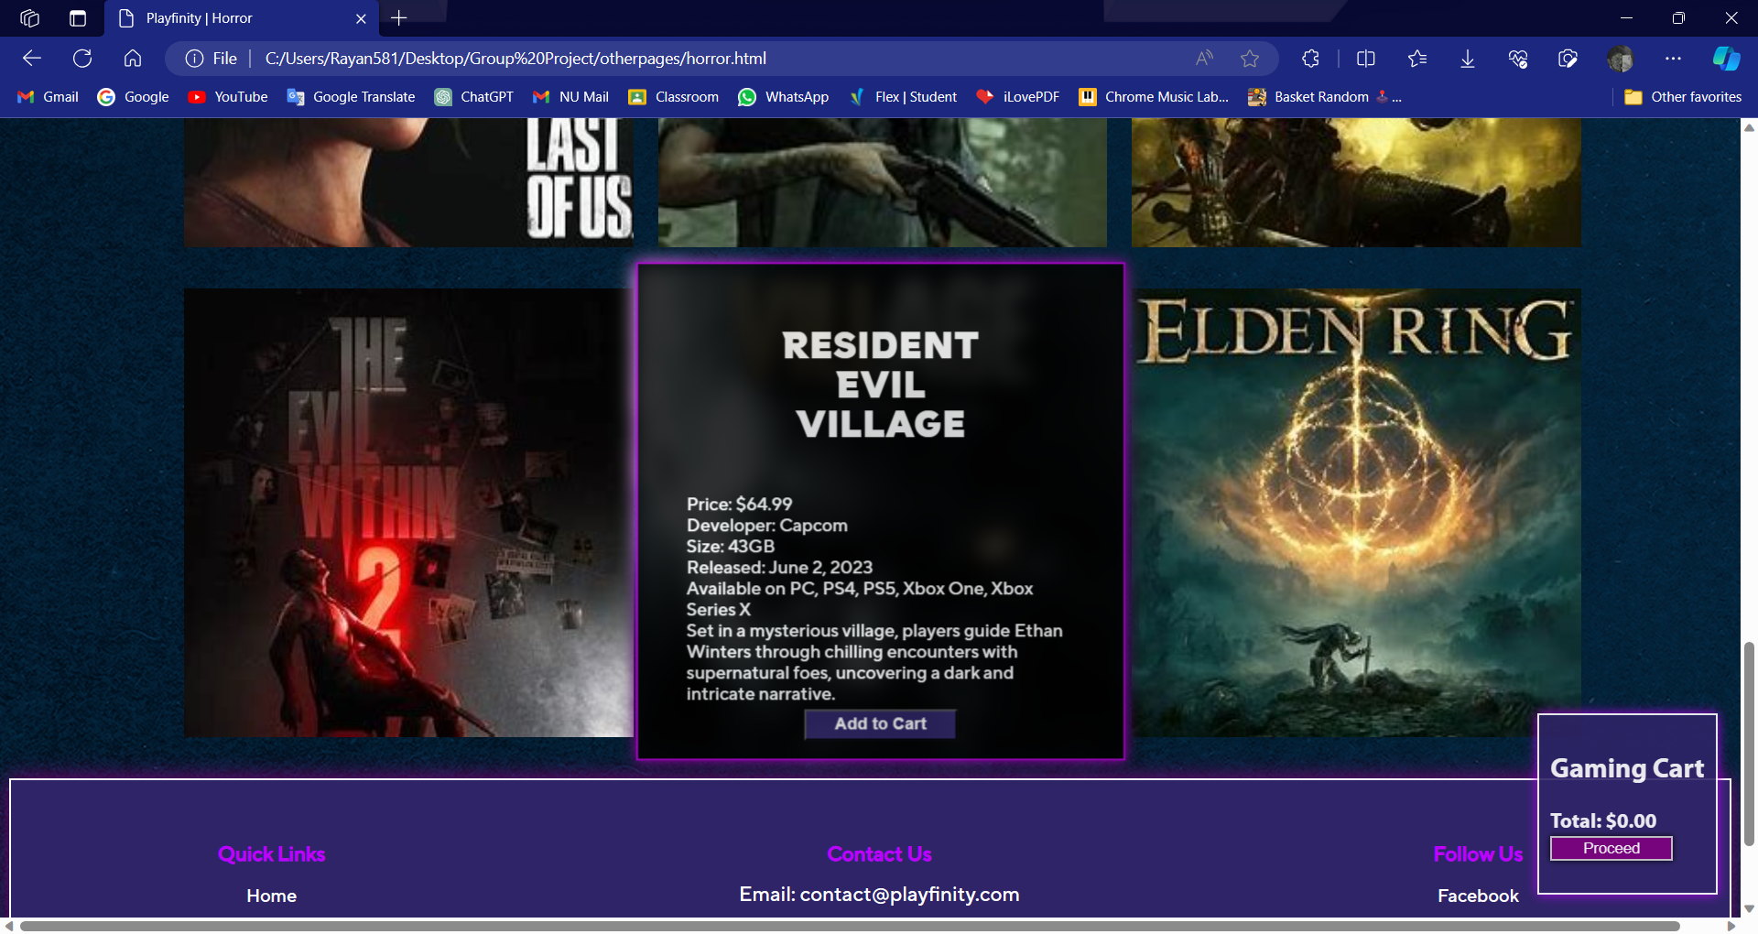
Category 4: Horror

Slide 9
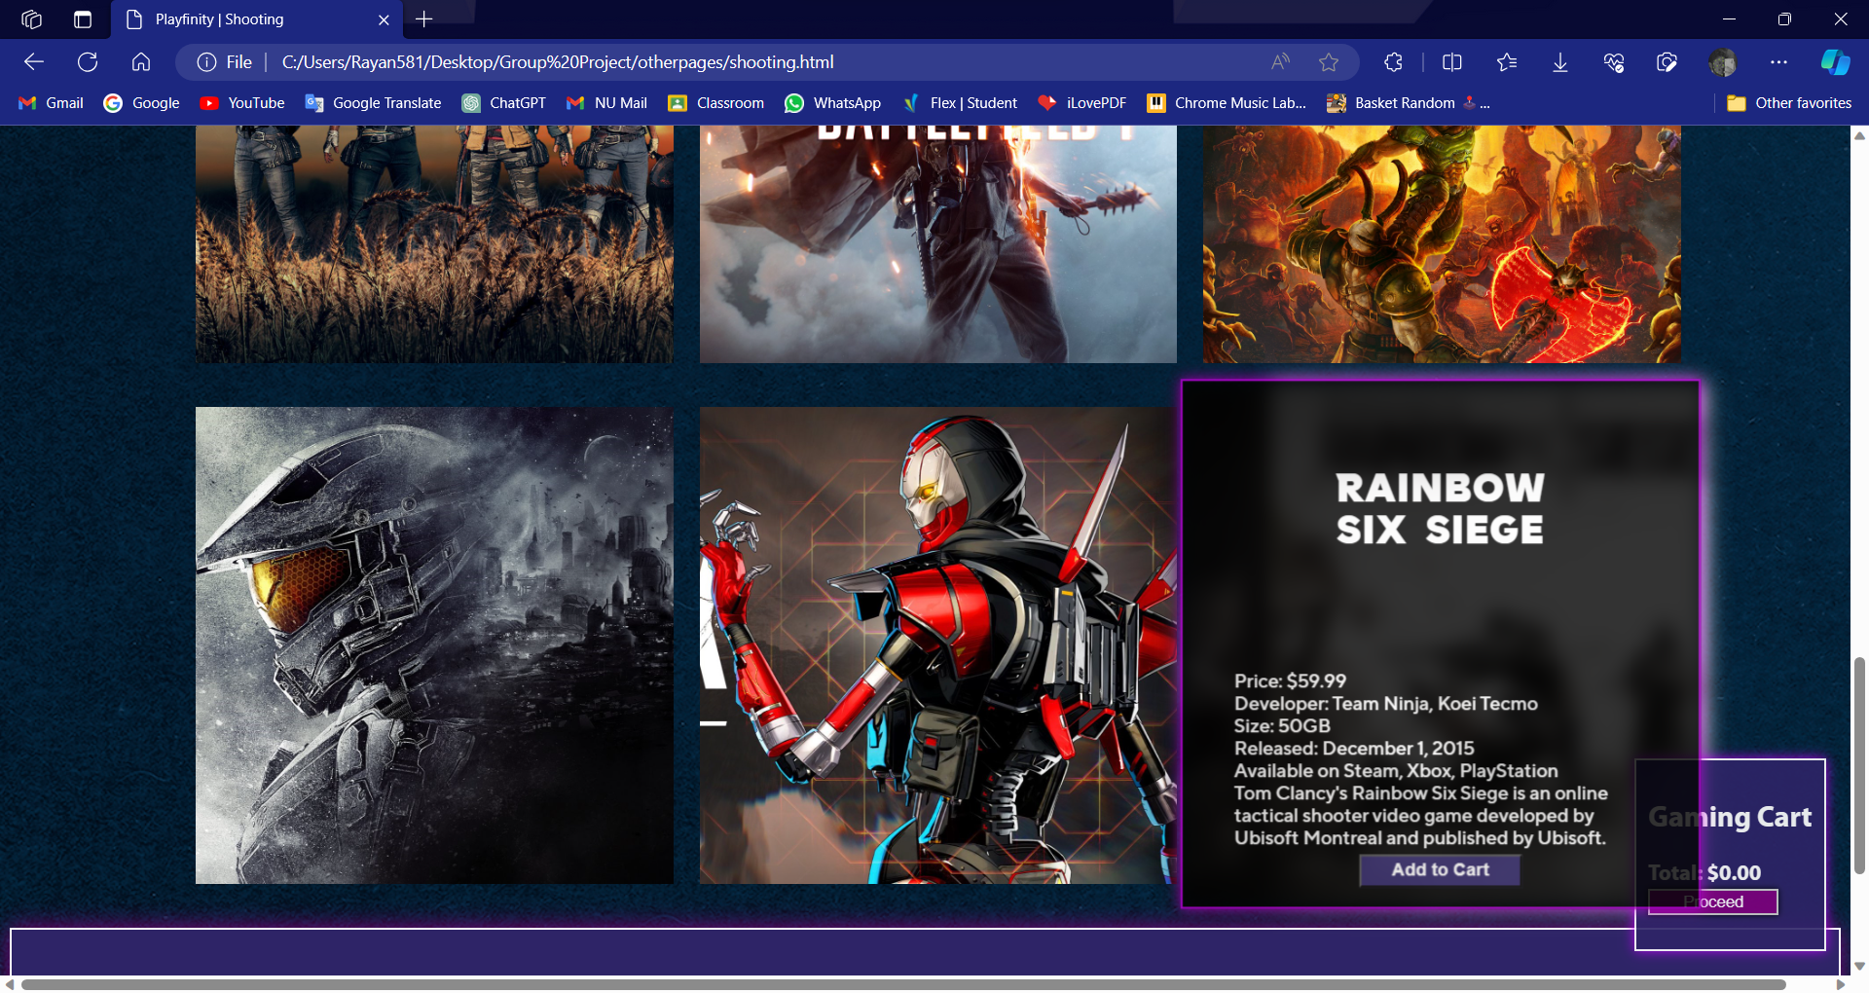
Category 5: Shooting

Slide 10
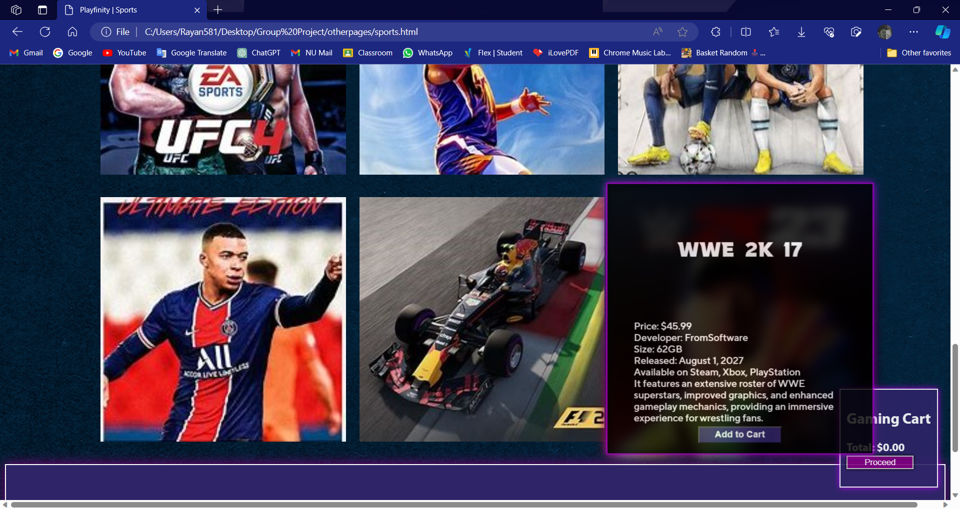
Category 6: Sports

Slide 11
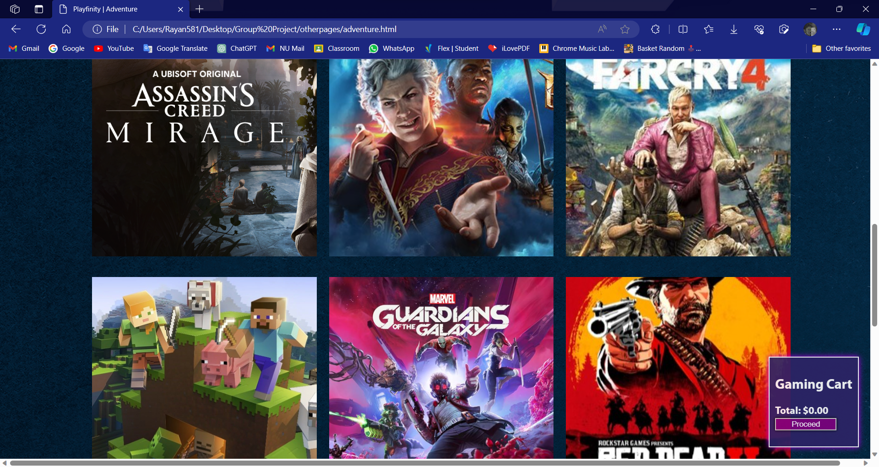
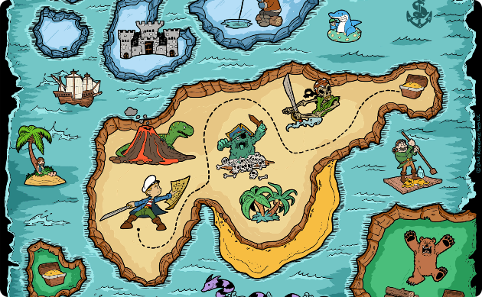

Category 7: Adventure
Embark on Epic Quests
Popular Games
Unleash your inner adventurer as you explore uncharted territories, solve mysteries, and uncover hidden treasures in thrilling adventure games.
The Legend of Zelda series
Uncharted series
Tomb Raider series

Slide 12
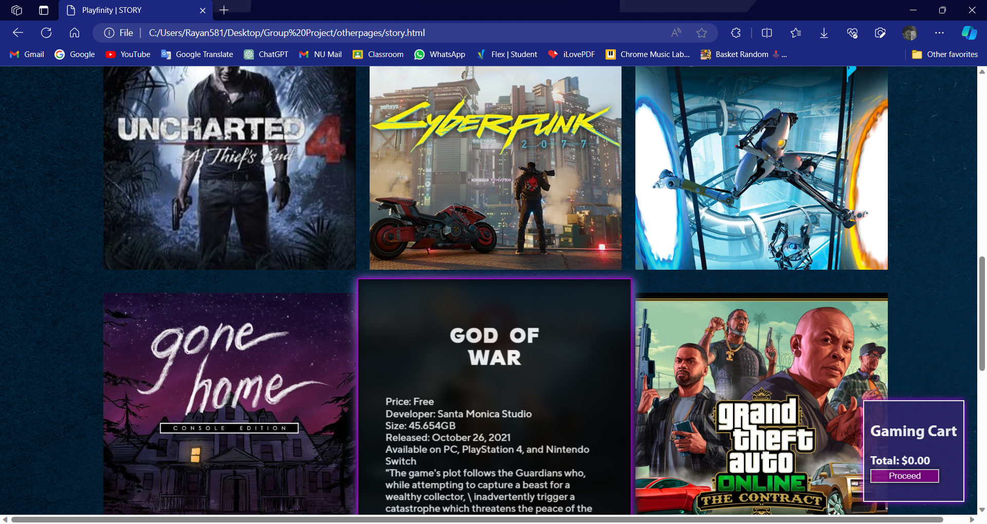


Category 8: Story
Beach Getaways
Popular Games
Indulge in serene beach destinations, bask in the warm sun, and let the soothing sound of the waves wash away your worries.
The Last of Us series
Life is Strange series
Detroit: Become Human

Slide 13

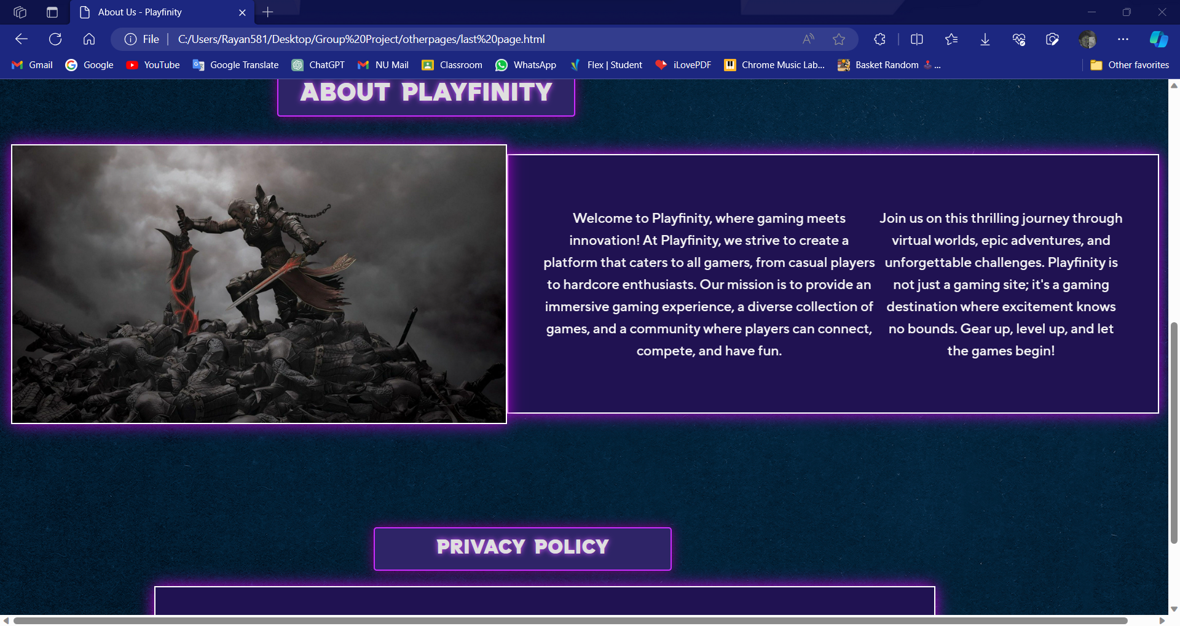
ABOUT PAGE
BY CLICKY “ABOUT US” on the Home page you can read about PLAYFINITY with all the details you want to know about

Slide 14
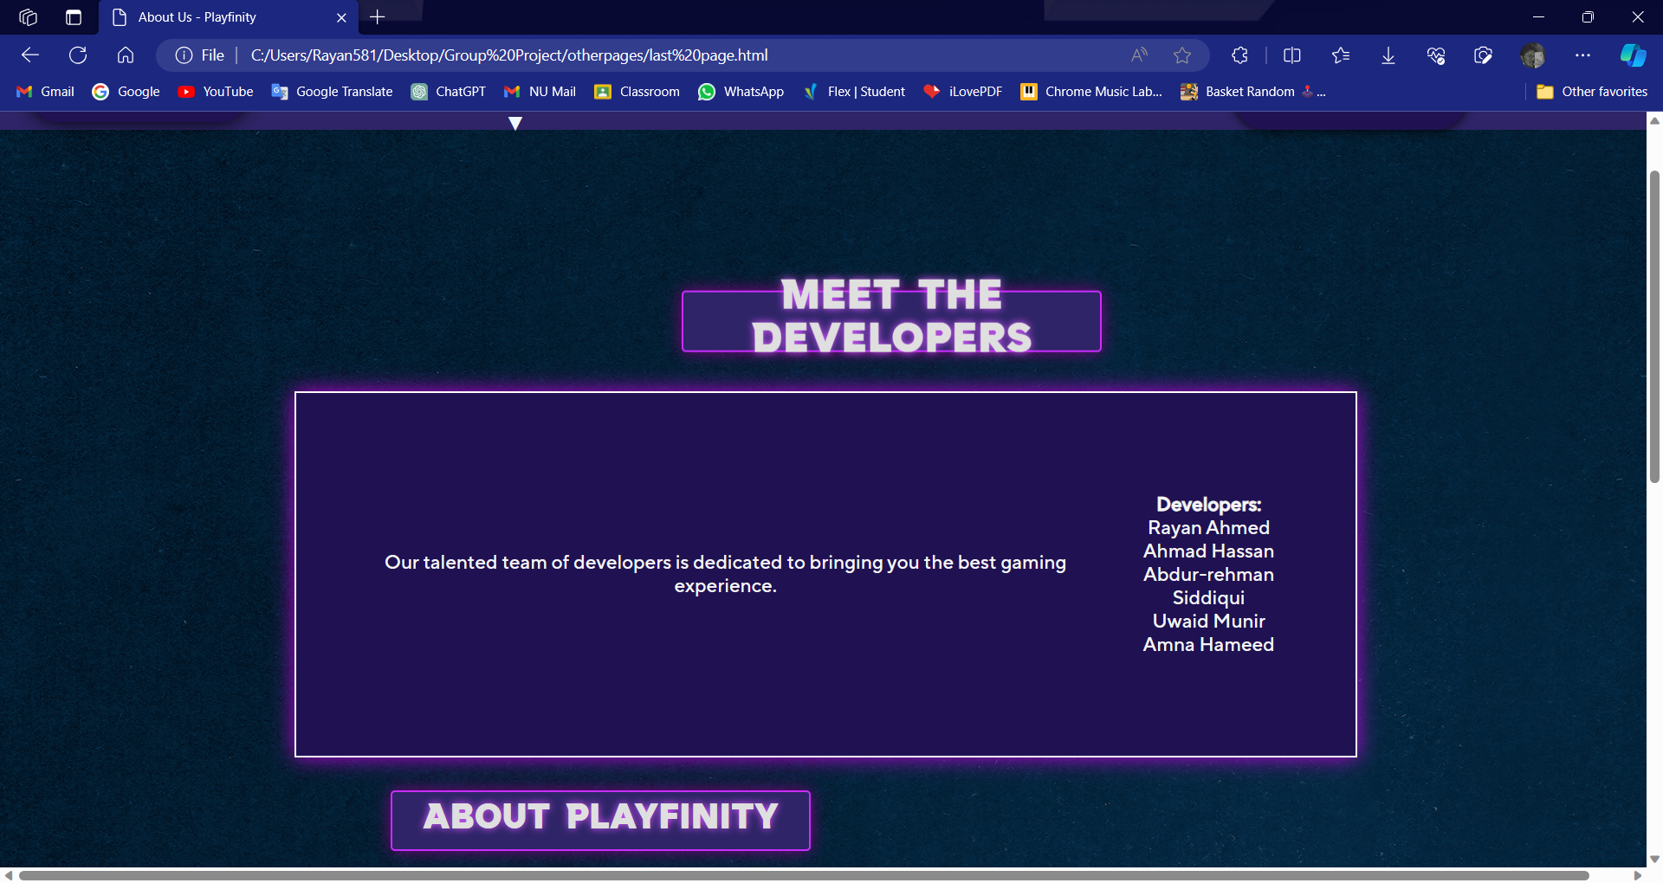
CREDITS TO OUR DEVELOPERS !!

